Slide 1
FORM DESIGN

Slide 2

1. HOME PAGE

Slide 3
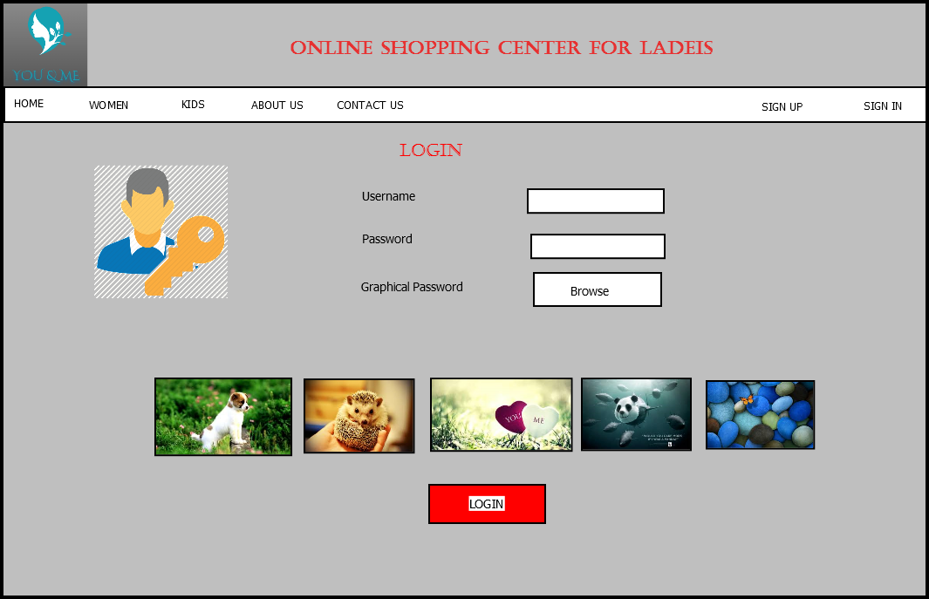
2. LOGIN PAGE

Slide 4
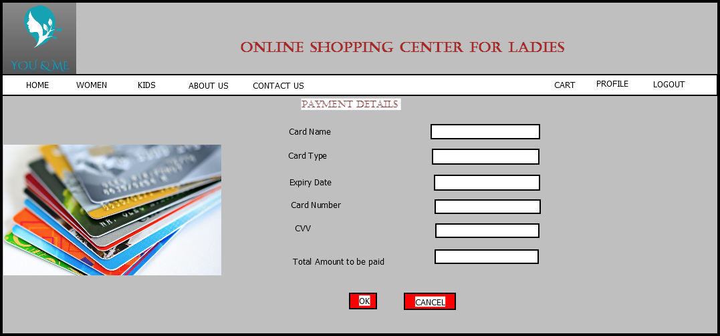
3. PAYMENT PAGE

Slide 5
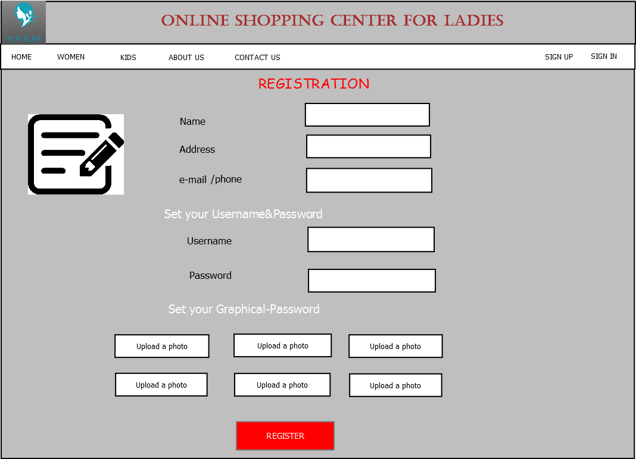
4.REGISTRATION PAGE

Slide 6
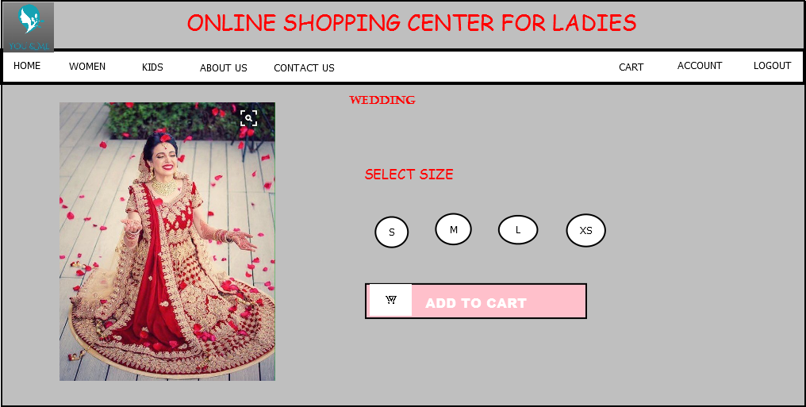
5. WEDDING DRESS

Slide 7
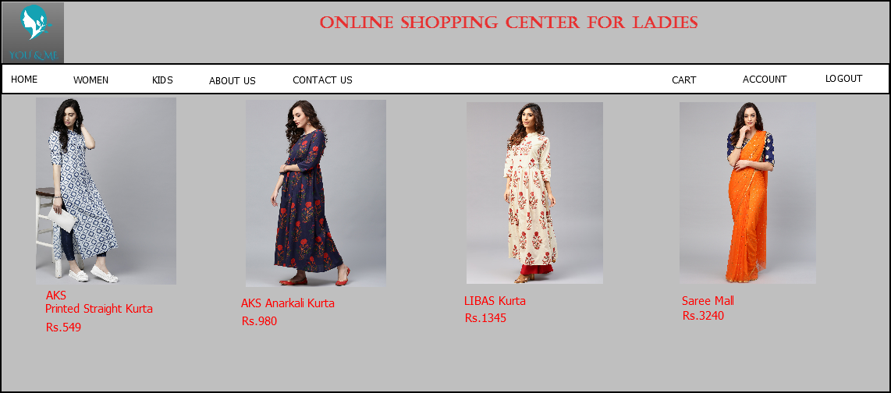
6.TYPE OF DRESS

